Slide 1
Personal Key Indicators of Heart Disease
David Seo

Slide 2
Why Preventing Heart Disease is Significant
Heart Disease is the leading cause of death in the United States
About 1 person passes away from heart disease every 36 seconds in the U.S.
Costs the U.S. $363 Billion dollars per year (including: health care services, medicines, lost productivity due to death)
Individuals 65 or older are more likely to get heart disease
Black, Native American, and Alaska Natives are more likely to experience heart disease than any other race

Slide 3

About the Dataset
Dataset was downloaded from Kaggle
Originally, from the 2020 Annual CDC survey data of adults related to their health status
Consists of 400K participants
Consists of 18 columns
Separated into three categories:
Preventable Factors:
BMI
Smoking
AlcoholDrinking
PhysicalHealth
MentalHealth
PhysicalActivity
DiffWalking
SleepTime
Diseases:
HeartDisease
Stroke
Diabetic
Asthma
Kidney Disease
Skin Cancer
Non-Preventable Factors:
Sex
Age Category
Race
GenHealth

Slide 4

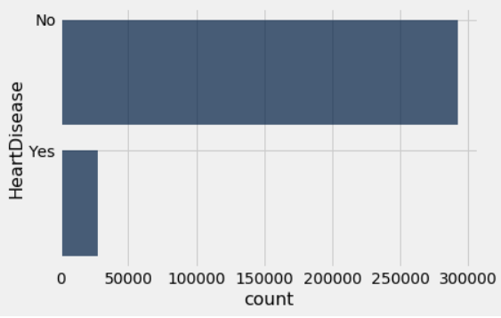
Prevalence of Heart Disease
Column consists of respondents that have ever reported having coronary heart disease (CHD)
Around 1 in every 10 individuals have heart disease

Slide 5
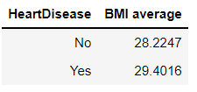
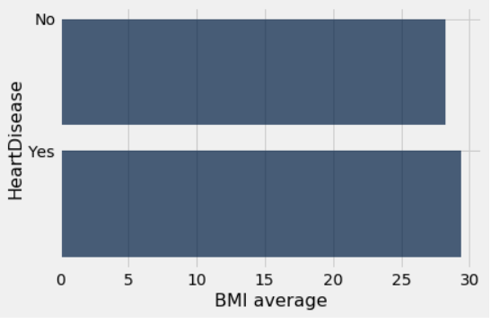
Is BMI associated with heart disease?
This column consists of Body Mass Index which is a measure of your body fat based on height and weight.
Average BMI was not significantly different between the two groups
However, after the permutation test…

Slide 6
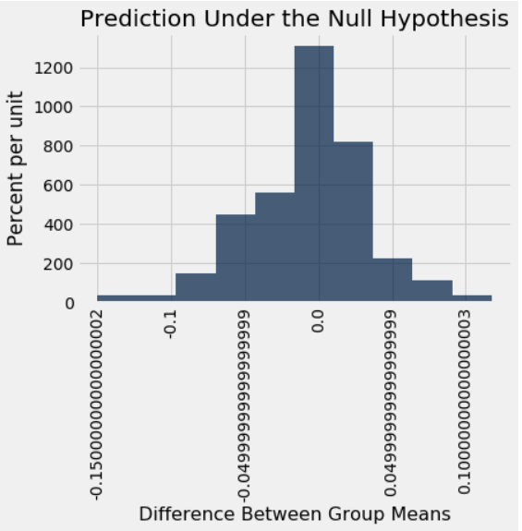
BMI Permutation Test
After running a permutation test, we see that there is a correlation between BMI and Heart Disease
Ran the Permutation test for the rest of the columns and got the same result of a small p-value
This likely means that the columns selected went through a screening process since they are all correlated to Heart Disease

Slide 7
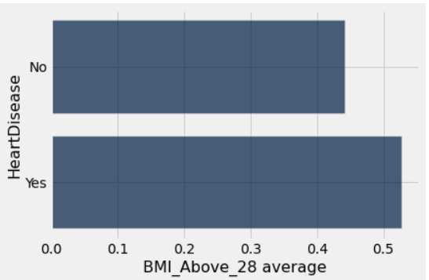
Percentage of Heart Disease in +28 BMI Group
52% had heart disease when their BMI was above 28

Slide 8
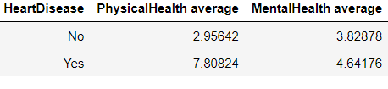
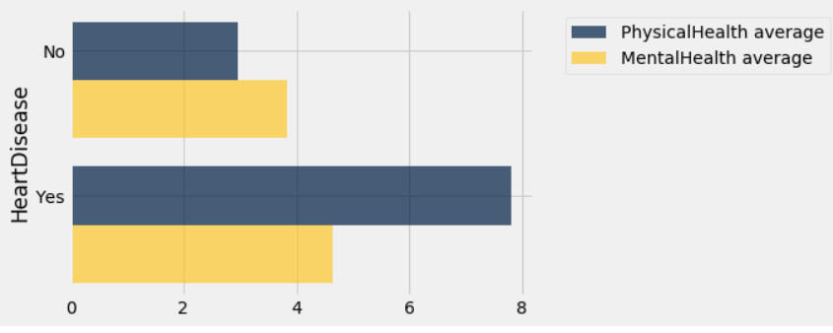
Impact of Physical and Mental Health in Heart Disease
Column consisted of asking participants: “Over the past 30 days, how many days would you consider them to be bad mental health or bad physical health days”
People with heart disease tends to have more bad days of physical and mental health

Slide 9
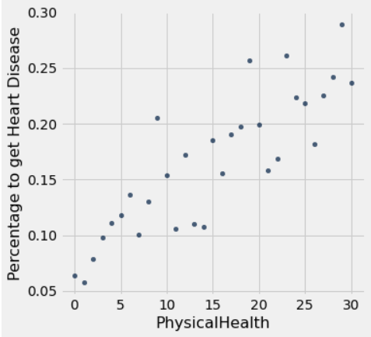
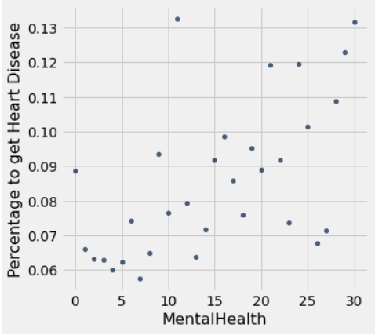
Physical/Mental Health Trend with Heart Disease
Linear Progression for both columns
Mental Health as more outliers

Slide 10
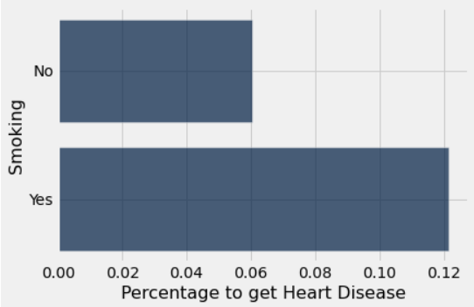
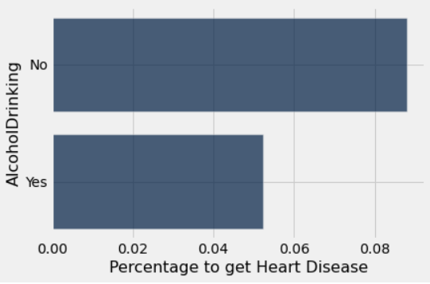
Impact of Smoking and Does Heavy Drinking Matter?
This column consists of asking participants “Have you smoked at least 100 cigarettes in your entire life?”
12% chance of having heart disease if you smoke
6% increased from No group to Yes group
This column consists of asking participants “Heavy drinkers (adult men having more than 14 drinks and adult women having more than 7 drinks per week
5% chance to have heart disease if you are a heavy drinker
3% drop from No group to Yes group

Slide 11
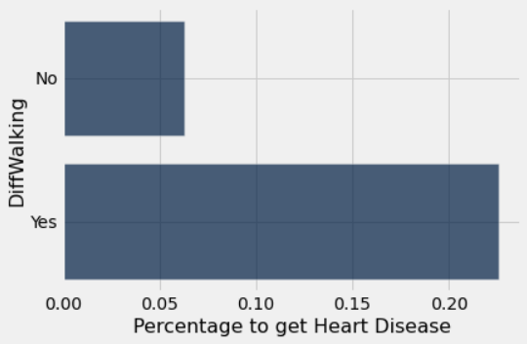
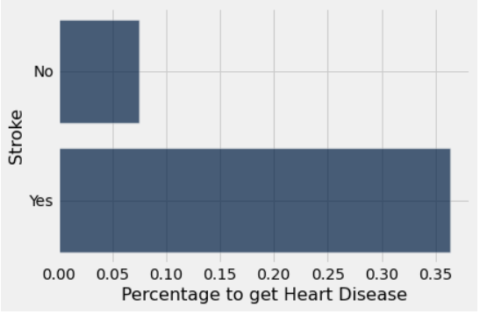
Difficulty Walking or Having a Stroke
Column consists of asking participants “Do you have serious difficulty walking or climbing stairs?”
22% chance of having heart disease if you have difficulty walking
16% increase from No group to Yes group
Column consists of asking participants “(Ever told) (you had) a stroke?”
36% chance to have heart disease if you ever had a stroke
29% increase from No group to Yes group

Slide 12
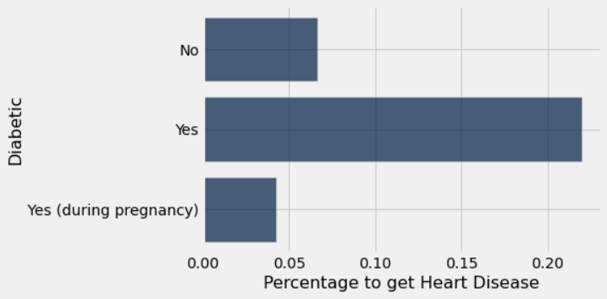
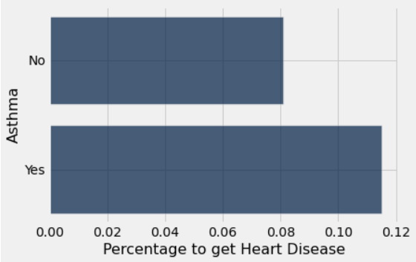
Impact of being Diabetic or Having Asthma
Column consists of asking participants “(Ever told) (you had) diabetes?”
21% chance to have heart disease if you are diabetic
15% increase from No group to Yes group
Note: No clarification if they are Type 1 or Type 2
Column consists of asking participants “(Ever told) (you had) asthma?”
11% chance to have heart disease if you have asthma
3% increase from No group to Yes group

Slide 13
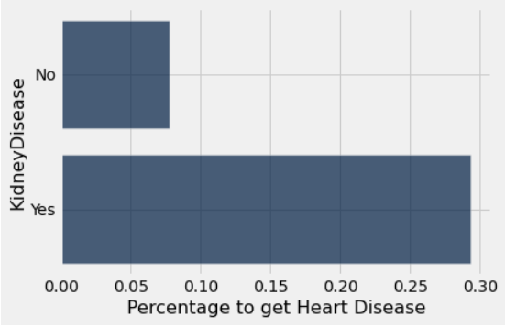
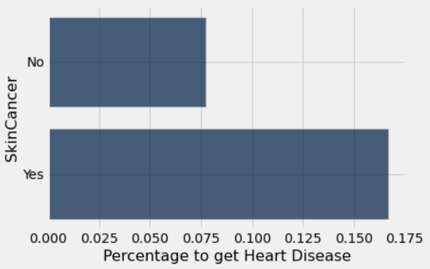
Impact Kidney Disease or Skin Cancer
Column consists of asking participants “Not including kidney stones, bladder infection or incontinence, were you ever told you had kidney disease?”
29% chance to have heart disease if you have kidney disease
22% increase from No group to Yes group
Column consists of asking participants “(Ever told) (you had) skin cancer?”
16% chance to have heart disease if you have skin cancer
9% increase from No group to Yes group

Slide 14
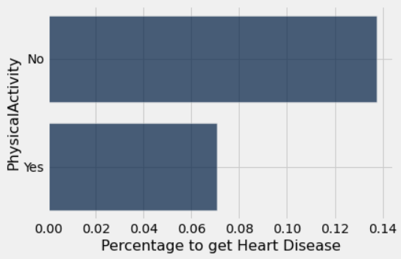
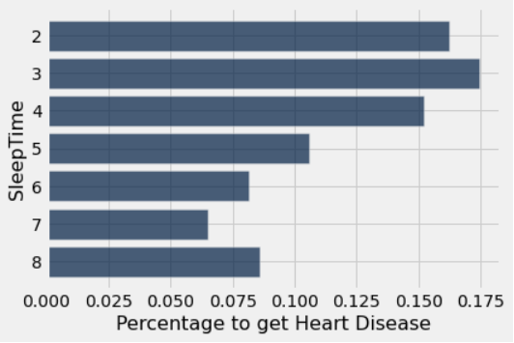
Does Physical Activity or Sleeping Matter?
Column consists of asking participants “Adults who reported doing physical activity or exercise during the past 30 days other than their regular job”
13% chance of having heart disease if you do not exercise
6% increase from Yes group to No group
Column consists of asking participants “On average, how many hours of sleep do you get in a 24-hour period?”
Higher the chance to get heart disease the less hours of sleep you get
Highest chance to get heart disease from 3 hours of sleep with it being 17%

Slide 15
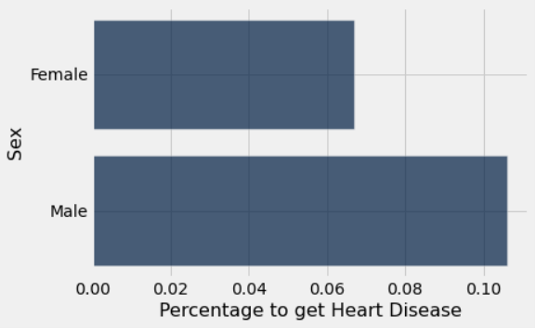
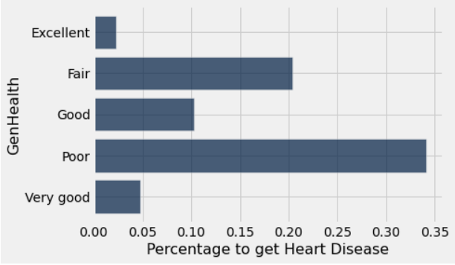
Are Men More Likely To Get Heart Disease and Does Generational Health Matter?
Column asked participants “Are you Male or Female”
Women have a 6% chance to get heart disease
Men have a 10% chance to get heart disease
Column asked participants “Would you say that in general your health is…”
34% chance to get heart disease if your gen health is poor

Slide 16
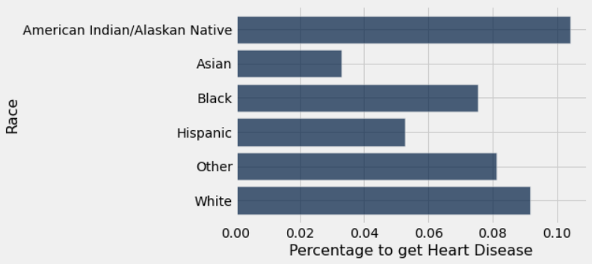
Does Race Affect Heart Disease?
Column consists of asking participants “What is your race?”
Chance to get heart disease:
American Indian/Alaskan Native - 10%
Asian - 3%
Black - 7%
Hispanic - 5%
Other - 8%
White - 9%

Slide 17
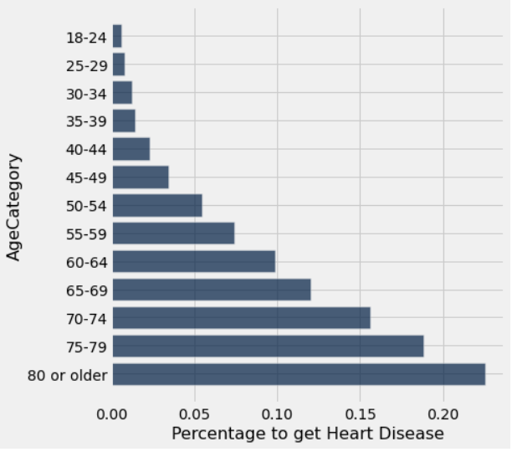
Is Age Related to Heart Disease?
Note: individuals 65 or older are more susceptible to heart disease
12% chance to get heart disease if you are between 65-69
15% chance to get heart disease if you are between 70-74
18% chance to get heart disease if you are between 75-79
22% chance to get heart disease if you are 80 or older

Slide 18
Likelihood to get Heart Disease by Findings
Preventable Factors:
Difficulty Walking - 22%
3 Hours of Sleep - 17%
No Physical Activity - 13%
Smoking - 12%
Heavy Drinking - 5%
BMI above 28% - 52% had heart disease
Bad PhysicalHealth Days - 7.8
Bad MentalHealth Days - 4.6
Diseases:
Stroke - 36%
Kidney Disease - 29%
Diabetic - 21%
Skin Cancer - 16%
Asthma - 11%
Non-Preventable Factors:
Poor GenHealth - 34%
Men - 10%
Women - 6%
Age:
65-69 - 12%
70-74 - 15%
75-79 - 18%
80 or older - 22%
Race:
American Indian/Alaskan Native - 10% (Highest)
Note: Correlation does not equal causation

Slide 19
Preventative Actions
Exercise to avoid physical issues such as difficulty walking
May also help mental health
Quit or do not start smoking
Get enough hours of sleep
Get screened if you have had a stroke, kidney disease, or skin cancer
Get screened if you are diabetic
Discover your generational health and get tested
If you are American Indian/Alaskan Native, get tested frequently

